Slide 1
Social Media 101
Everything you should know, want to know or already know about starting, operating and getting the most out of your professional or personal social media presence.
Notes:
Welcome to Social Media 101!
This presentation is to help you start or grow an online social media presence.
We will:
Define the value of social media in an online age
Help you understand your audience
Give you tips on how to generate the best and most appropriate content based on your goals and audience
We’ll talk about the different social media platforms out there and how to pick and use them
Go over the importance of Hashtags, tagging and link sharing
Suggest third party platforms that help you create better content
Look at an example of a good tweet and a bad tweet
Give you the confidence and tools to put your best social media foot forward!

Slide 2
Getting started- Ask Yourself
What is the value of having a social media presence?
What do I want to achieve through social media?
How much time am I willing to devote to social media, per day?
Notes:
What is the value of having a social media presence?
It connects you to collogues/organizations
Personify’ s your company/brand
You can be a cheerleader for your colluges from your desk
People can find your organization/work way easier
On an altruistic side, it has cultural significance.
Think about how you will use social media?
Are you promoting events? A specific project?
Do you generate regular content (blog posts, videos, photos etc.) and want to share it with an audience?
Are you (reasonably) opinionated and want to commentate in areas of your expertise (But be warned: there is a fine balance of educated and respectful debate and outright trolling. If you’re going to be antagonistic then get outta here.)
How often?
Let’s face it: social media is a TIME SUCKER. You need to think a bit about how much time you want to spend a day on social media
I probably spend an average of 3 hours per day managing our (and my) social media accounts.
Consider scheduling, developing a plan and sticking to it or even hiring someone to manage your accounts it it’s something you really need/value.

Slide 3
Choose Your Channels
The main social media platforms are Twitter, Facebook, LinkedIn and Instagram
What platforms suit your needs?
Have a profile picture! If the profile is for a company, its logo is fine but if it’s personal/professional a headshot is a must.
Have a bio! 100 words MAX.
Think about how your tone changes between the platforms
What is a twitter voice verses a LinkedIn voice? Think: Job Interview vs Small Talk
Notes:
Pick channel(s) that suit what you are trying to accomplish. Think about WHO your audience is. WHERE are they coming from? And WHAT are they doing on your page?
A profile picture is a MUST. If your name is in the handle then it should be your face beside it.
A bio is also a MUST: sum up who you are and what you do in at least 100 words MAX. Doesn’t need to be a novel, but have a clear point of contact: an email, web link, newsletter sign up etc.
TONE/VOICE
The social media profiles and corresponding settings as an analogy:
Twitter: Bus stop/Public Transit/Food Court- a lot of people a lot of half-baked thoughts. This is great for posting really anything, events, new content, news articles, photos, support for other organizations, events you’re not directly involved in. It’s a lot of different conversations happening in the same place
Facebook: Community board/ Hanging with family and friends- more curated, people who want to be there do it more consciously. Best for events, new content promotion. Share things that YOU created here.
LinkedIn: Think of as an online resume or networking events. Post news releases, interesting news/academic articles, events you are directly involved in.
- LinkedIn is the “buttoned up” platform. It is where people come to check YOU out before making any contact. LinkedIn is a first-impression platform so do keep it clean, professional and simple.
Instagram: The red carpet, well manicured and stunning visuals. Anything visual, photos/videos. Capturing events. New content as well.

Slide 4
Other social media channels to keep in mind
Notes:
A few more to consider:
YouTube: You automatically have a YouTube channel if you have a Gmail address. Springboard uses its YouTube channel for our promotional videos (like our NSERC videos). If you have good video content, it’s wise to set up a YouTube channel
Reddit: The home of the AMA- ask me anything- format. This is great if you’re a big company/institution and if you can convince your CEO/President to volunteer themselves for an AMA.
Tumblr, Google+ and Snapchat are just a few more examples of what’s available in this wide world of possible social media platforms. Heads up to parents: look out if your kid/teen has Snapchat. It’s a photo sharing app that lets you send photos to your friends that disappear forever once their opened. Spooky.

Slide 5
Think About Your Social Media Strategy
Goals
Audience
Content
Notes:
Develop a strategy! Three things to keep in mind are your: Goals, Audience and Content
GOALS:
What are you trying to accomplish with a social media presence? Define your goals. Are you building an engaged audience? Just sharing news? Monitoring your community? Having a few defined goals in mind helps in shaping your overall social media image.
For example: Springboard’s social media goals are to: Celebrate and promote the work of our network, share info and keep our network updated on events/news/opportunities, build an engaged online community that reflects and shares our values.
AUDIENCE:
Who is your audience? Is it researchers? Students? Other organizations? Think about who you are “talking” to and how you can best engage your audience through content/tone. For example, students/younger audiences respond to memes and .gifs
CONTENT:
What are you posting?
Think about what you’re posting. If you’re promoting an event, check out to see what others are saying about it. Learn about the relevant hashtags

Slide 6
Getting the most out of your posts
Working with word limits
Hashtags
Less is more- Get creative!
Think visually
Notes:
Working with word limits: Facebook, LinkedIn and Instagram are usually fine but Twitter has a 280 character limit (up from 150). Be concise. Brief. And to the point.
Include any relevant links! If you are including a link, try using Bitly. Which is a third-party link shortener, you copy your long link in and it spits out a BitLink that looks like bit.ly/ajhdk
Hashtags are usually one or two words used to generate buzz. It’s common to see a specific hashtag being used for events like #BIC2019, #AVF2019
They can also be used to refer to entire communities, like #startupeast #TeamSB – see if your institution has its own hashtags (#DalProud etc.)
Hashtags can have huge impacts in our society today, look at how the #MeToo, #TimesUp and #NeverAgain movements gained traction.
Use VISUALS. I cannot stress this enough. Tweets and posts with text only are likely to be glossed over by your audience. Add a photo, the “add image” button is usually right next to the send button. USE IT. Even if it’s a standard stock photo. Find a relevant visual you can attach and do it!
You can find stock photos at unsplash.com
Try to say it in as few words as possible. The old adage that a picture is worth 1000 words is so TRUE for social media.
Get creative- try new things! Try a giveaway, a tag a friend challenge, social media takeover (guest spots), go live, you can say a lot without actually saying it.

Slide 7
Springboard Hashtags and Abbreviations
#TeamSB
#springboarding*
#SBAtlantic
#Province
#Institution
#Sector
#startupeast
#AtlInnovation
#AtlanticGrowth (ACOA)
#AtlanticCanada
DYK? Did you know?
ICYMI- In Case You Missed It
FYI- For Your Information
RT - Retweet
TY – Thank You
v – very
w/ - with
Fwd- forward
Abt- about
Pls- please
Notes:
The primary hashtag we use is #TeamSB- it was #springboarding but a lot of snowboarders use that one. That’s a good lesson though, see who else is using that hashtag and what for. Maybe you’d want to rethink that you’re using to make your hashtag even more effective.
You can also just hashtag a strong noun, like #innovation #research etc. Whatever the “buzz word” is- it can likely become a hashtag.
You can check the popularity of any given hashtag by just clicking on it and it’ll show you how other people are using it
In Atlantic Canada it’s common to see whatever province in a hashtag, also the sector.
Check to see if your institution has it’s own hashtag it uses – you’ll see a lot of #DalProud #AcadiaProud etc.
Abbreviations help you get buzz and reduce your word count. It’s all about communicating concisely and effectively. Common ones on professional social media accounts are ICYMI (in case you missed it) DYK (did you know?) and FYI (for your information) you’ll still probably see the occasional OMG (oh my god) LOL (laugh out loud)
Don’t overdo them though because people still need to be able to read things.

Slide 8
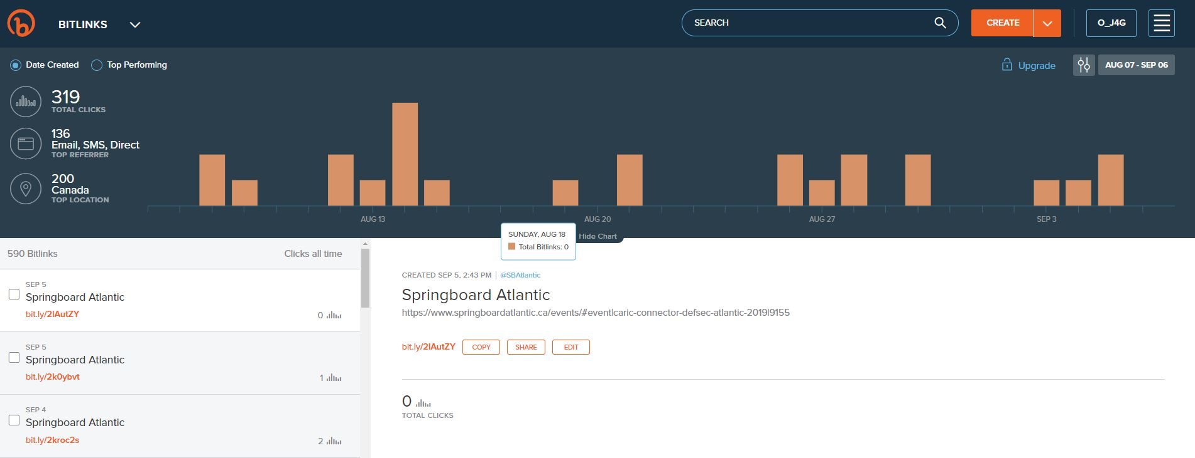
Shortening Your Links With
Notes:
With only 280 characters we can’t waste precious space on long hyperlinks.
Like scheduling, there are many softwares that can shorten your external links. The solution? Bitly!
Bitly is the platform that Springboard and many others use.

Slide 9
Scheduling Posts
Scheduling is great for events and hacking a busy work schedule.
There are a lot of platforms you can use to schedule posts, Hootsuite, Friends+Me, Tweetdeck -to name a few
Good posts to schedule are events, registrations, programs etc. Things with a flexible timeline
We use Tweetdeck and Hootsuite (albeit not often)
Don’t schedule everything
Notes:
Scheduling is a great way to beat the time-sucking nature of social media. If you can devote an hour or two one day to scheduling out all your social media posts for the next week. Perfect.

Slide 10
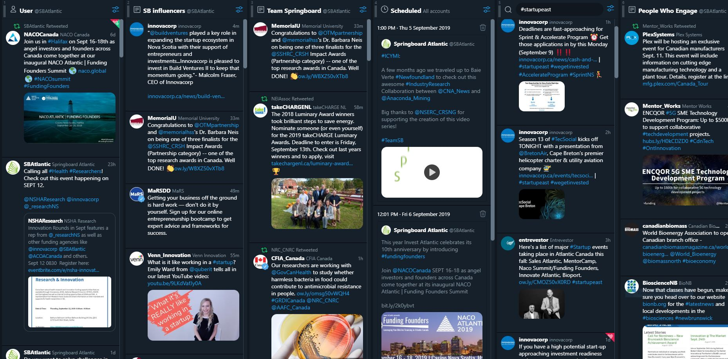
Notes:
An example of our Tweetdeck. You can customize each panel to hashtags, a number of profiles, users, etc.
You can customize your columns to create a feed that works for you/what you want to moniter
You can tweet straight from Tweetdeck as well.
There are some quirks: like you can’t tag people in photos on Tweetdeck

Slide 11
Growing Your Page
Invest a set amount of time in managing your profiles
‘Like’, Share, and Reply to Posts- Engage!
Be reasonably consistent
Follow relative profiles
Notes:
TIME INVESTMENT: We already touched on the time aspect but I cannot stress this enough, you need to invest the time in doing social media. Find a time/routine that works for you if you can’t consider if you can hire someone.
LIKE AND REPLY: It’s common courtesy to reply to tweets or comments on your post. This is also subjective though as sometimes ‘bots’ will spam you. You don’t need to respond to spam or objectively unrelated content. You also don’t have to respond to negativity, but don’t delete entire tweets because someone comments a snide remark, that’s their issue, not yours.
BE CONSISTEINT: Both in post frequency, topics, themes and tone.
FOLLOW: Following people is fun! It builds community and lets you stay connected to other people or organizations with similar goals. More often than not, people will follow you back!Plus it gives you more avenues to just retweet or reshare other’s content.

Slide 12
Social Media Etiquette
Reply
Engage
Don’t ‘fake’ it
You’re not obligated to respond to negativity
Notes:
There is an “etiqute” to social media.
- If someone reaches out to you- Reply! Especially when someone sends you a DM (direct message).
Reply and engage to people! It is SOCIAL media after all
Faking it:
Be you genuine self (within reason) don’t try and put on a social media “persona” because your followers can generally see through that. Be honest, informative and approachable.
Being your honest/professional self will cultivate richer online communities and promote rigorous discussions
Social media has an overall tone of bubbliness, positive, supportive and informative. Keep those words in mind as you go forth with your profile.
- Don’t get caught up in the vanity of it all. Yeah it’s great to have a huge following but if it becomes an ego project, chances are the quality of your content will suffer.
Negativity: You are not obligated to respond to trolls (internet speak for those types of people who like to be negative for the sake of it). You are not responsible for negative reactions, sure you may get them, but unless someone is legitimately misinformed and you can calmly and politely correct them, then negative comments are not worth engaging with

Slide 13
Do’s and Don’ts of Twitter: Examples
DO:
DON’T:
?????
Notes:
Let’s get into some examples:
DO:
-A clear call to action, NEW BLOG, NEW VIDEO, something that lets the viewer know that we have news/something exciting/ worth sharing
-We @ people who are INVOLVED- it makes people uneasy when their @’ed in things they don’t know about
-We have a relevant/community hashtag!
-A shortened link that takes the viewer to our website, we’re converting viewers into readers, conversion
-Top it off with a high-quality relevant photo
- Protip: Twitter doesn’t count line spaces as a character. Indent your thoughts!
DON’T
Don’t make up your own slang! It’s… lame.
Capitalization is good when used correctly. Online it reads as shouting so use it for important info/dates. We try to be positive on social media. Don’t call people crazy and don’t capitalize it- that’s like screaming on the internet.
So much punctuation! You only get 150 characters per tweet. Don’t spend it on ( ‘ “ .. ! Use punctuation seldomly.
Avoid creating long threads- If you can’t sum up your thought in one or two tweets, consider posting elsewhere, creating a blog or, NOT AT ALL
WHERE ARE THE HASHTAGS?
Avoid personal opinion, fact check things, avoid ironic hypocrisy
Don’t attack the fundamental pillars of democracy, like free press

Slide 14
Letting go of your social media anxiety
Spell check/ fact check
Hit that send button!
Share and re-share
You can always Delete
Notes:
The biggest hang-up we have about hitting that send button is the fear of how others will perceive you/your brand. It’s time to let that fear GO
Check for spelling mistakes and facts, make sure your dates are right and that all names are spelled correctly
As long as you’re not sharing untrue or harmful info- it’s fine! Hit that send button.
It’s okay to reshare the same content a few times a week, especially for something like a blog post or an exciting announcement. This is always a good time for a #ICYMI hashtag. If it’s important, scream it from your online rooftop.
Re share the same content! If you’re having an event you don’t have to tweet about it just once, talk about it every day!
Don’t take yourself too seriously. People aren’t constantly policing your words and tone. Just share the message and be upbeat about it!
What I went over today isn’t gospel. You can tweet things without hashtags or pictures, you can share a long link. It’s okay to miss a day if you’re busy. Above is just some standard tips and tricks to keep in mind as you get started or continue your social media page.
If all fails, you can always delete it.

Slide 15
Follow Us!
@SBAtlantic
Springboard Atlantic Inc.
@sbatlantic
Springboard Atlantic Inc.
Notes:
Thank you!
Make sure to follow all of Springboards pages ☺

