Slide 2
The Business Side of the License

Slide 3
The following presentation is not to be construed as representing the policies of the Beckman Coulter Diagnostics, The University of Southern California, or The Association of University Technology Managers. The content is solely for purposes of discussion and illustration, and is not legal advice.

Slide 4
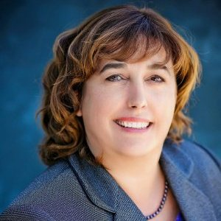
Traci Libby is the Director of Open Innovation for Beckman Coulter Diagnostics, a Danaher Company. In this capacity, she has global responsibility for the company’s external partnerships, including intellectual property licensing, collaborative development partnerships, strategic alliances, distribution relationships, and other non-M&A partnering transactions. Prior to her role at Beckman Coulter, Traci was Director of Licensing and Innovation Partnerships at Thermo Fisher Scientific (Life Technologies / Invitrogen) for 17 years, where she was responsible for intellectual property in-licensing, sponsored development partnerships, external technology sourcing and asset acquisition, as well as oversight of license compliance activities.
Throughout her career, Traci has fostered innovation as a key growth driver across the global life science and healthcare community, enabling the application of cutting-edge technologies to meet key customer needs in the research, diagnostic, and applied life science markets. She is a member of LES, AUTM, the CONNECT Commercialization Council, and the BIO Technology Transfer Committee. Traci obtained her undergraduate degree in biochemistry and cell biology at the University of California, San Diego, and did her graduate studies in molecular and cell biology at San Diego State University. She brings over 25 years of industry experience, spanning innovation development, intellectual property strategy, product management and marketing, and partnering for successful commercialization.
Traci Libby, CLP
TLLIBBY01@Beckman.com

Slide 5
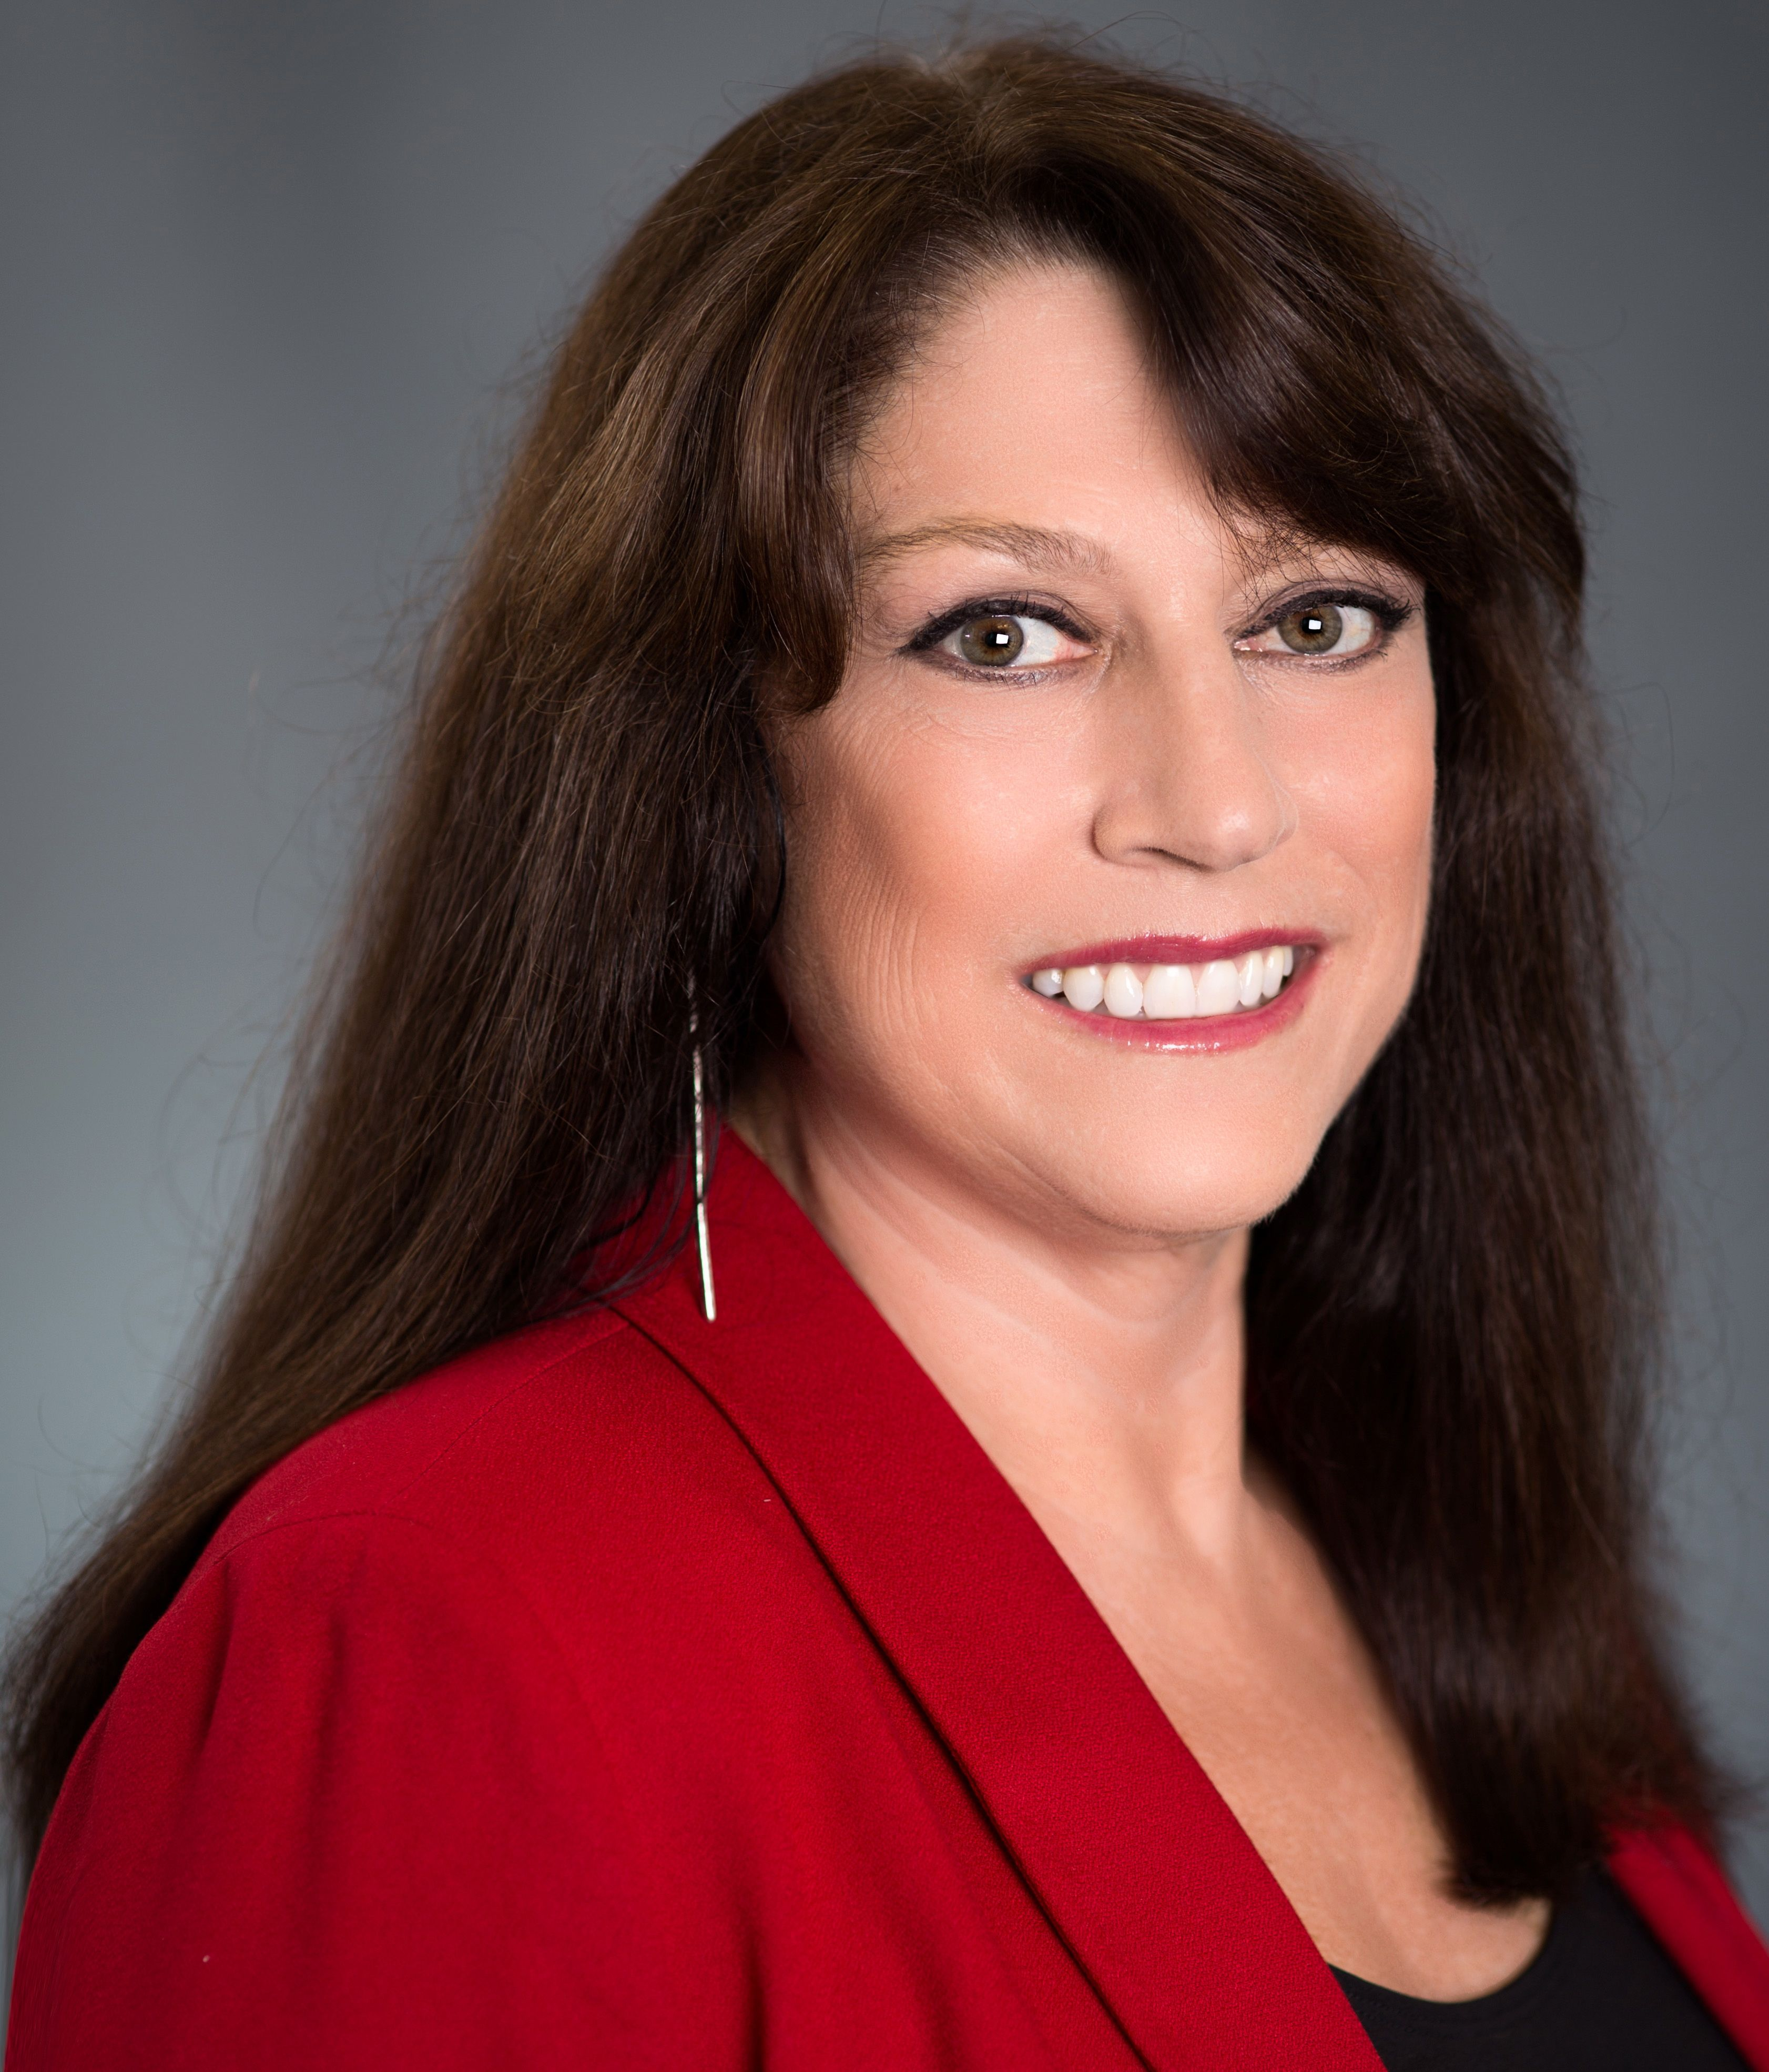
Jennifer Dyer is the Executive Director of the USC Stevens Center for Innovation, a university-wide resource for USC innovators designed to harness and advance the creative thinking and breakthrough research at USC for societal impact beyond traditional academic means. She leads a team of 27 who manage university-owned IP stemming from nearly $700 million in annual research funding in all areas of the University including medicine, engineering, sciences and the arts. USC Stevens focuses on the licensing of technologies, expanding industry collaborations, supporting start-ups and entrepreneurial programs for students and faculty.
Jennifer has more than 25 years of experience and a strong record of success in technology commercialization, including serving as Director of Technology Development at The Scripps Research Institute and as a Corporate Development Consultant at Life Technologies Corporation (now Thermo Fisher). Her experience includes supervising more than 1000 agreement negotiations for intellectual property rights.
Jennifer Dyer, CLP
DyerJ@usc.edu

Slide 6
Today’s Agenda
Why License?
Types of Licensees and their motivations for licensing
Alternatives to Licensing
Developing the Licensing Strategy
Capturing Value and the Long View
Key Business Issues
Rights, Financials, Control, Diligence, Enforcement, Reporting
Equity
Tips for interacting with Industry
The license is signed. Now what?

Slide 7
The Basics -- What is a License?
An agreement in which rights are granted to a party under a patent, biological materials, copyright, or other intellectual property
A patent provides an ability to EXCLUDE another party from practicing the patented subject matter in a territory in which the patent is ISSUED (Right to Block)
It does NOT guarantee that the subject matter can be practiced without infringing someone else’s patent. (FTO)

Slide 8
Why License?
An Academic View
Disseminate academic knowledge for the public good
Economic Development
Generate funding for the institution
Satisfy institutional metrics
PI-driven factors / Faculty Retention

Slide 9
Why License?
An Industry View
Exclusive:
Gain a territory-specific competitive advantage for product commercialization
Potential for improved profitability through decreased competitive pressure
Ability to exclude competitors
Generate sublicensing revenue / Defensive value
Potentially reduce product development time (speed to market)
Display a larger IP portfolio to prospective investors (start-ups)
Gain a strategic or financial advantage when planning to license other pieces of subordinate IP
Non-exclusive:
Mitigate Risk – Non-exclusive freedom-to-operate licenses

Slide 10
Types of Licensees and Their Motivations for Licensing
Types of Licensees & Their Motivations for Licensing
Start-up
Secure a fundamental asset for building a product offering
Display a larger IP portfolio to prospective investors. Anticipate a future acquisition.
Achieve a third party funding milestone
Non-practicing entity (aka “Patent Troll”)
Generate revenue through threat of enforcement
Large Entity
Exclusive:
Secure sustainable competitive advantage and increased margins
Compress product development timelines
Non-exclusive: Mitigate legal risk of enforcement

Slide 11
Alternatives to Licensing
Types of Licensees & Their Motivations for Licensing
BATNA: Best Alternative to a Negotiated Agreement)
Design-around: Develop and commercialize an alternative product design that will not utilize the relevant issued patent claims
Manufacture, Use, and Sell in non-patented geographies
Challenge a patent to delay its issuance/enforceability (interference, opposition, post-grant review)
Option agreement – cap downside risk
Establish an invalidity and/or noninfringement position and prepare to defend against the possibility of enforcement
Opportunity cost

Slide 12
Developing the Licensing Strategy - Capturing Value and the Long View
Types of Licensees & Their Motivations for Licensing
Existing company? Spinout? Both?
Market leader? New entrant?
How much exclusivity? How many licensees?
Understand the impact on market dynamics for an exclusive versus non-exclusive approach
Fields of Use?
A thinly sliced exclusive license = a non-exclusive
To succeed as a licensor, your licensee(s) must also succeed. Consider the potential impact of your licensing strategy on your licensees.

Slide 13
UnderstandING the Licensee’s Business Model
Types of Licensees & Their Motivations for Licensing
How will the licensee be generating revenue?
Understand the value of the product or service AND the relative value of your IP in that value stream
Know how the licensee views the market and competition
Understand the licensee’s business model
How will the licensee make money?
How will the licensee finance their business (start-ups)?
Who is the customer for the product (end-users, manufacturers, service providers)
Is reimbursement/price controls an issue?
Role of distributors and sublicensees

Slide 14
UnderstandING the Licensee’s Business Model (Continued)
How important is your IP?
Give a blocking (monopoly) position?
Bundled with other IP? (royalty stacking and combo clauses)
Does it provide Freedom to Operate?
Necessary vs. nice to have
Geographical coverage vs. licensee and competitor footprint

Slide 15
Financial Components of a License
Pre commercialization
Licensee fee (cash or equity)
Expense reimbursement (e.g. Patent Costs)
Milestone payments
Maintenance fees
Commercialization
Royalties & sublicense fees – sharing in financial benefit of the IP, on either an absolute or relative basis
Fixed Fee agreements
Fully-paid agreements
Research Support? What if the licensor isn’t interested in a collaboration?

Slide 16
Equity Components in a license
When and why do Universities take equity
Option for startup companies
In lieu of an upfront license fee
Non-dilution
Effect on ability of company to raise capital

Slide 17
Key Business Issues
Scope of Rights being granted
Patents – patent maturity, geographies, nature of patent claims
Copyrights
Know-how
Biological Materials
Field of Use – RUO, Applied Markets, Dx, Therapeutic indications
Territories
Exclusivity
Retained rights
Future rights
Financials
Net or Gross Sales basis (+ Kit Combo and Royalty Stacking provisions)
Fixed Fee
Running royalties
Sublicensing terms – aggregate percent versus pass-through
Change of control fees

Slide 18
Key Business Issues - Continued
[Kit] Combination Provisions
Royalty paid on Net Sales X (A/B) where A is the value of the product that would be considered a licensed product if sold as a stand alone and B is value of the entire product.
Combo Provisions account for the likelihood that a patented component may be sold with non-patented components for purposes of providing a more convenient solution for a customer. Examples include multi-component kits, arrays with content from multiple sources, multi-module instruments.
Royalty Stacking (anti-Stacking) Provisions
Royalty rate will be reduced by 0.5% for each 1% owed to a third party, to a floor of [50%] the nominal royalty rate.
Royalty stacking provisions account for the likelihood that a licensee may need to obtain licenses from multiple sources to have freedom to operate for a product.
Combination and Royalty Stacking Provisions are not mutually exclusive.

Slide 19
Key Business Issues - Continued
Patent Rights
Control of Patent Prosecution
Selection of Outside Counsel
Sublicensing and Enforcement Rights
Infringement
Who controls prosecution of infringers?
Who pays expenses?
How would revenue from settlements be shared?
Risk of mistakes
Risk to patents from court decisions
Importance of National Phase in Germany

Slide 20
Key Business Issues - Continued
Diligence
Product development (FOIA caveats)
Commercialization - Resist the urge to dictate the licensee’s marketing plan
Product development doesn’t always go as planned
Minimum annual royalties
Understand what is within licensee’s control
Reporting Obligations
Audit Rights

Slide 21
Tips for interacting with industry
Larger companies have multiple stakeholders with defined roles: Business Development, R&D, Legal, Finance, Marketing, Commercial. Expect decision-making to require internal alignment > Be consistent, no late surprises
Adherence to timelines and risk mitigation are important drivers – a business may be building its timelines around the expectation that a license will be completed by a certain date.
Be able to support your “asks” with rationales. Expect the same of your partner.
Talk before redlining to minimize turns of the document
Work in problem-solving mode – articulate your concerns/needs and be receptive to alternative language for contentious clauses

Slide 22
Tips for interacting with industry (Continued)
Not all $$ are equal. Accounting treatment and timing of expenses matters, especially to large companies.
Corporate budgets are often adjusted quarterly. Prolonged negotiations can lead to loss of available investment dollars.

Slide 23
The Beginning of a Partnership
CONGRATULATIONS! The License is Signed. Now What?
The signed license agreement is the beginning, not the end, of the “real work” for technology transfer professionals
Successful technology transfer requires management of signed agreements, well after the “ribbon cutting” ceremony is over
Continuity in relationships will have significant benefits WHEN (not IF) questions arise down the road. (Even the best contract can rarely overcome a bad relationship.)
View the agreement as a “Living Document” that may need to evolve over time, as the scientific, IP, and commercial landscape changes and your licensee’s business needs evolve.

Slide 24
License auditing - Considerations
Formal audit vs. informal discussion
Revenue reports and royalty calculation methodology
Notifications required / typical timelines for audit
Party authorized to perform an audit
Allowable scope of audit (e.g. records, geographies, operations)
Allowable usage of audit information
Cost of audit (including underpayment threshold for cost shifting)
Resources required for an effective audit of an IP license
Accounting
Legal
Technical
Risks (and benefits) of triggering audit provisions

Slide 25
Product Development matters
Scientific challenges for the licensee (benchtop science versus manufacturing scale-up, shelf-life considerations, efficacy/toxicity issues)
Principal Investigator suggestions for new products or marketing activities
Regulatory hurdles – changes in the regulatory landscape
Third party IP barriers: Cross-licensing to resolve FTO issues
Changes in the competitive landscape

Slide 26
IP Matters and other transactional considerations
Enforcement / Licensee competition with unlicensed entities
Ensuring that the Licensee benefits from having taken a license
Benefits and risks of enforcing a patent
Patent prosecution matters
Control of patent prosecution (scope of claims, use of outside firms)
Geographies for coverage (US vs. major markets vs. worldwide)
Patent strategies (re-exams and interferences)
Expansion of the Principal Investigator’s IP Portfolio
Acquisition of the Licensee
Assignment and Change of Control Provisions
Royalty Buyouts

Slide 27
Managing licensee relationships
“In the Business World, the rearview mirror is always clearer than the
windshield” – Warrren Buffet
The signed license agreement is usually based on the best information available at the time.
For nascent technologies, however, assumptions may be inaccurate and need to be revisited for several reasons, including:
Over/under estimation of market size or adoption rates
Over/under estimation of technology value proposition
Emergence of disruptive alternatives
If the existing agreement is uneconomic, it may be preferred to revisit the terms versus compromising the opportunity. Requires ongoing communication and transparency.
Requires sophistication on behalf of the licensor to understand that the goal is not to maximize the royalty rate, but to maximize the overall licensing opportunity. To help yourself, help your partner succeed.

Slide 28
THANK YOU!
Questions?
Traci Libby, CLP
TLLIBBY01@Beckman.com
Jennifer Dyer, CLP
DyerJ@usc.edu

